Slide 1

Implementation of LDPC Decoder
Group ID : 6
Team ID : 4

Slide 2
HONOR CODE
We declare that,
The work that we are presenting is our own work.
We have not copied the work (the code, the results, etc.) that someone else has done.
Concepts, understanding and insights we will be describing are our own.
We make this pledge truthfully. We know that violation of this solemn pledge can carry grave consequences.
-Signed by
All members

Slide 3
TABLE OF CONTENTS
1. Main learnings
6. Alternate ways of implementation of Decoders
2. Problems & Solutions
7. Summary
3. Implementation of Channel & Decoders
8. Contribution Table
4. Numerical Results
9. MVP of Group
5. Monte Carlo Simulation
10. References & appendix

Slide 4
1
MAIN LEARNINGS

Slide 5
MAIN LEARNINGS
We came to know about the various functions of C++ which are used to generate the random numbers which are useful in various fields (here we have used it for creation of BEC and BSC channels).
Functions used for this purpose are rand(), srand(), and RAND_MAX.
We gained more knowledge about the LDPC codes and its use as error correcting code.
We learned about the MAP data structure which is available in STL library of C++.

Slide 6
MAIN LEARNINGS
Also, we came to know that in C++, very small float values get converted into the Not a Number and then it would result in the error in further calculation. So, we can use a IsNaN() function which is available in C++ which returns true if it is not a number, otherwise return false.

Slide 7
2
PROBLEMS AND SOLUTIONS

Slide 8
PROBLEMS AND SOLUTIONS
At the initial stage, it was hard for us to understand the message passing from VN to CN and CN to VN in the tanner graph.
During the implementation process, the first thing that we had to select was the appropriate data structure which could easily implement tanner graph and have minimum time complexity.
The first thought was to use an array which was basically the same as the H matrix. But it would have very high time complexity as we would have had to traverse all the rows for particular VN and all the columns for particular CN.

Slide 9
PROBLEMS AND SOLUTIONS
So, we had decided to use the STL MAP which would store the index of all the CN connected to a particular VN and the index of all the VN connected to a particular CN. It would reduce time complexity.
Even after using the map, time required for the code to decode the received message was very high, so we had to optimize the code.
Initially, we have used three nested for loops which increased the time complexity of message passing and decoding of the received message.

Slide 10
PROBLEMS AND SOLUTIONS
For optimization, we added a break statement condition which would break the loop of message passing if after completion of an iteration the message was same as the previous message.
The number of iterations and simulations have been decreased by us .
For the BEC soft decoding, the decoding rate was very low because of the repeated multiplication of the probability.

Slide 11
PROBLEMS AND SOLUTIONS
So, instead of using normal likelihood ratio, we had used the log–likelihood ratio which involves addition instead of multiplication.
We have used the formula to calculate the log-likelihood ratio(link provided in references).

Slide 12
FLOW OF OUR WORK
First of all we have gathered knowledge pertaining to the process of message passing( from CN to VN & VN to CN).
Then, we implemented the process of message transfer using the tanner graph.
After that, we have implemented the BEC & BSC channels and checked their performances by simulations.
In next step, the code of BSC Hard decoder have been implemented.

Slide 13
2
IMPLEMENTATION OF DECODER AND CHANNEL

Slide 14
IMPLEMENTATION OF CHANNEL
The channel introduces the noise in the original transmitted message.
The noise can be produced by generating random 0s and 1s where 1 represents the error bit(in this case as transmitted message is all 0s).
The probability of the 1s is equal to the error probability of the channel. Thus, we can generate the 1 when the random number between 0 and 1 generated by the rand()/RAND_MAX (functions of C++) is less than or equal to the error probability.
For BSC, if the noise is 1 then the bit in the original message is flipped while in BEC, the bit is erased.

Slide 15
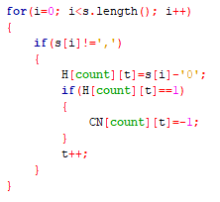
TANNER GRAPH IMPLEMENTATION
To implement message passing using tanner graph we need some table kind of structure and that we have made using multidimensional map.
So while scanning the H matrix wise whenever H[i][j] is 1(where i is the index of i^{th} row and j is index of j^{th} column) we add j^{th} VN in i^{th} CN.

Slide 16
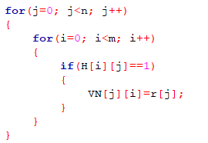
TANNER GRAPH IMPLEMENTATION
And in the same way, we scan the H matrix column wise and whenever H[i][j] is 1, we add i^{th} CN in j^{th} VN.

Slide 17
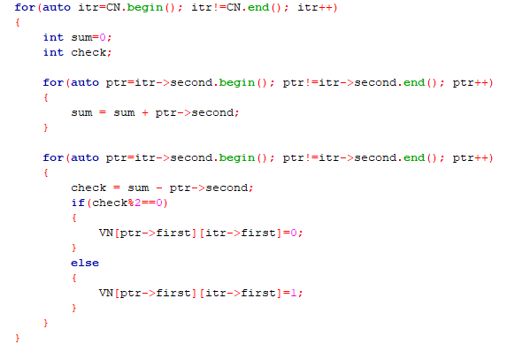
HARD DECISION DECODING
a) For BSC :
CN to VN message passing :
As you can see, firstly the first outermost for loop will visit all CN’s one by one and in each run, get the sum of all the VN’s values connected to it. By using 2nd for loop, CN will send the modulo 2 sum (sum=original sum – VN’s own value) to the connected VN.

Slide 18
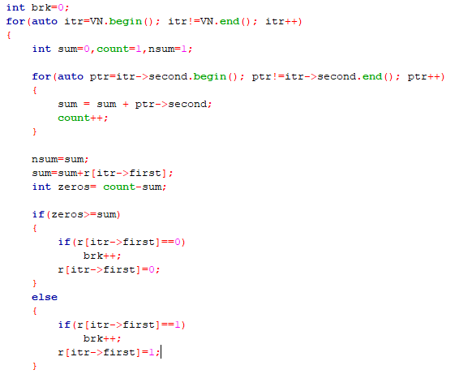
HARD DECISION DECODING
VN to CN message passing :
For the VN to CN message passing, we have to first make the bit decision.
For bit decision, every VN will sum all the values that it has received from the CNs and the previously received value and do majority voting to decide it’s value.

Slide 19
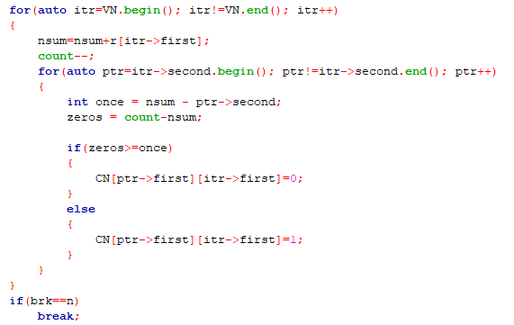
HARD DECISION DECODING
If for all VN’S bit are same as previous one then it would break this whole message passing process.
For the very first time VN just send the received value to all the CN. As you can see, to send message to CN connected to that VN, we do the majority voting of other CN’s that are connected to it and decision bit.

Slide 20
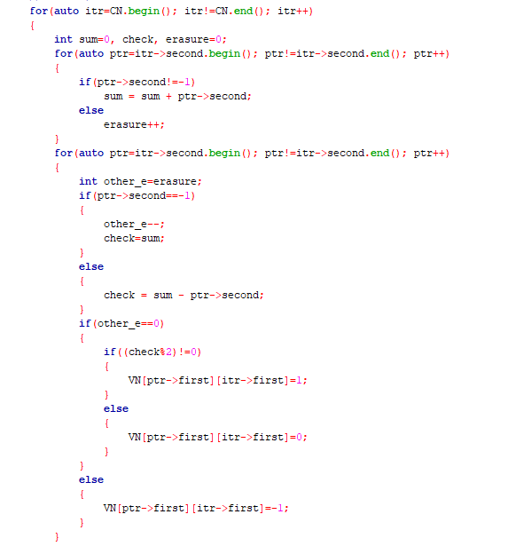
HARD DECISION DECODING
b) For BEC :
CN to VN message passing :
Here using first inner for loop we have calculated the no of erasure and the sum of non erased value so while sending message to the VN using 2nd inner for loop, first we have calculated the number of erasure except that particular VN and if it is non zero send it erasure else modulo 2 sum value.

Slide 21
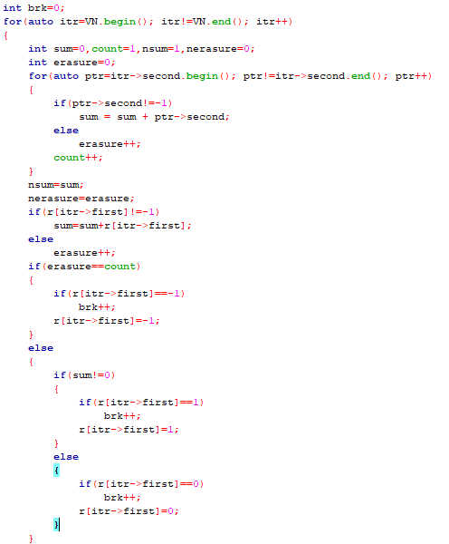
HARD DECISION DECODING
VN to CN message passing :
For the VN to CN message passing, we have to first make the bit decision.
For bit decision, we just count number of erasures and sum of all non erased values for all the CN’s and previously received value and do bit decision.

Slide 22
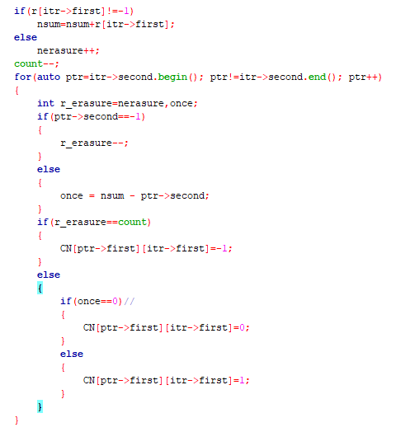
HARD DECISION DECODING
As you can see, firstly the first outermost for loop will visit through all VN’s one by one and in each run, for every CN that are connected to a particular VN, it send erasure if all the CN and the received bit are erased. Otherwise, it send the value of un-erased bit.

Slide 23
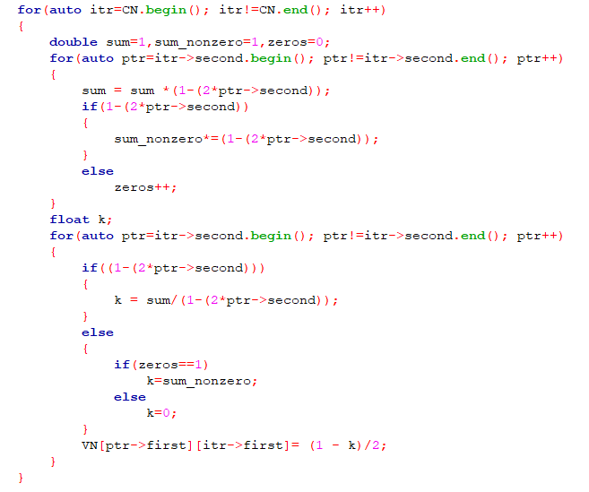
SOFT DECISION DECODING
a) For BSC :
CN to VN message passing :
As you can see, the first outermost for loop will go through all CNs one by one, and in each run, for every VN that is linked to a certain CN, it will communicate the probability that the value of this VN is 1, regardless of the received value, and we have used the Gallager equation to compute this..

Slide 24
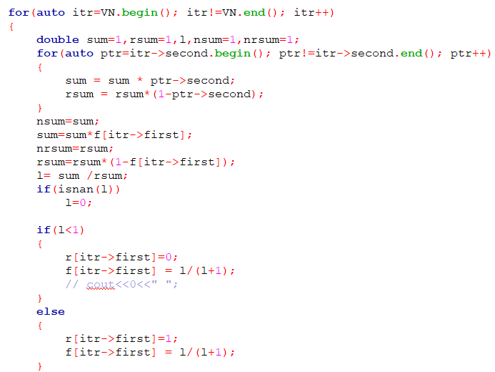
SOFT DECISION DECODING
VN to CN message passing :
For the VN to CN message passing, we have to first made the bit decision.
For bit decision, Every VN will calculate the likelihood ratio using the values it has received from all the CN’s that are connected to it and previous decision value and take decision according to this ratio value.

Slide 25
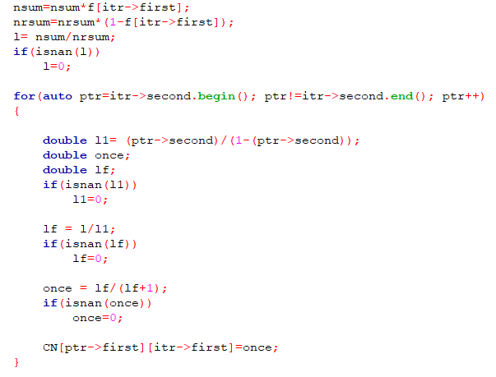
SOFT DECISION DECODING
For VN to CN message passing, every CN that are connected to a particular VN, it send the likelihood ratio for that CN, according to the values present in other CN that are connected to it and decision value. The value of probability is calculated using l/(l+1), (where ‘l’ is likelihood ratio) formula so we don’t need to worry about the finding constant value (α).

Slide 26
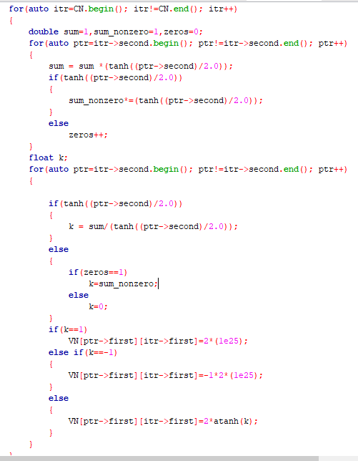
SOFT DECISION DECODING
b) For BEC :
CN to VN message passing :
As you can see, firstly the first outermost for loop will visit through all CN’s one by one and in each run, for every VN that are connected to a particular CN, it would send the log likelihood ratio for that VN, for that we have done the required calculations as shown in the reference link.

Slide 27
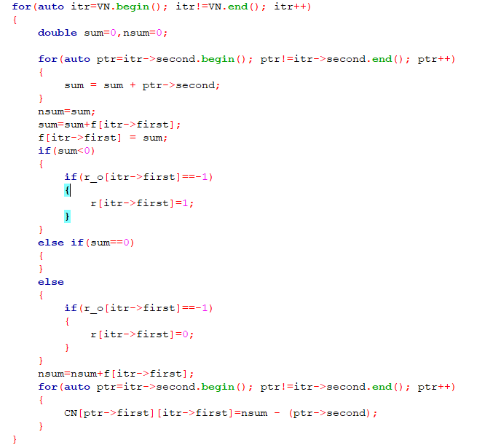
SOFT DECISION DECODING
VN to CN message passing :
For this process we have to make the bit decision.
For bit decision, every VN will sum all the values that it has received from the CN and the previously received value because here we are doing calculations in log so multiplication is not need, take decision accordingly. Note that it will be updated only if originally received value was erasure.

Slide 28
3
NUMERICAL RESULTS

Slide 29
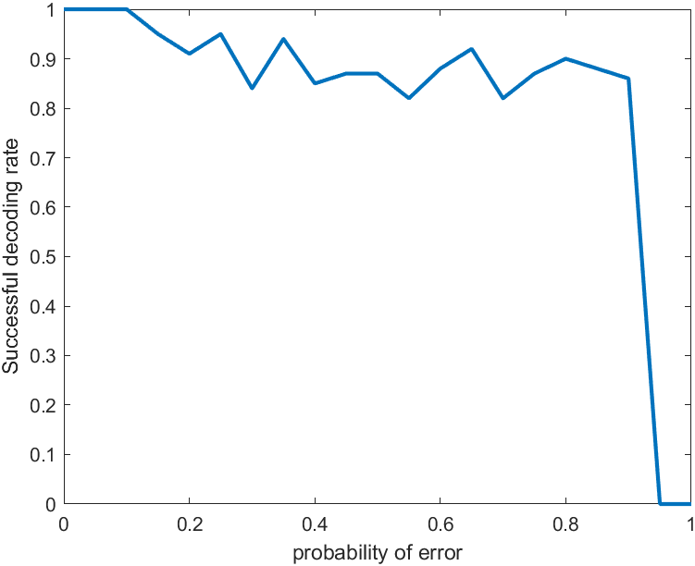
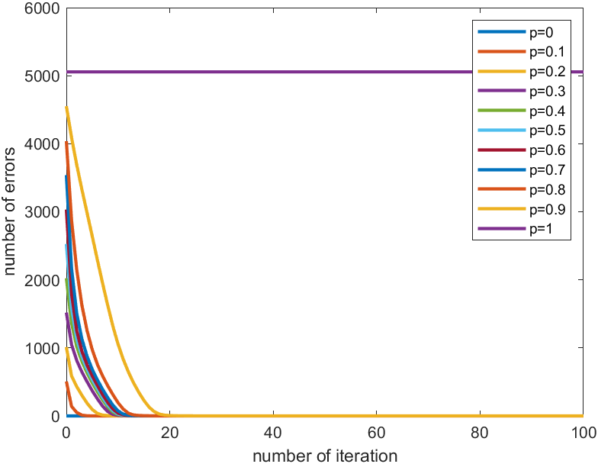
NUMERICAL RESULTS
a) BSC hard decision:
For Hmatrix1:

Slide 30
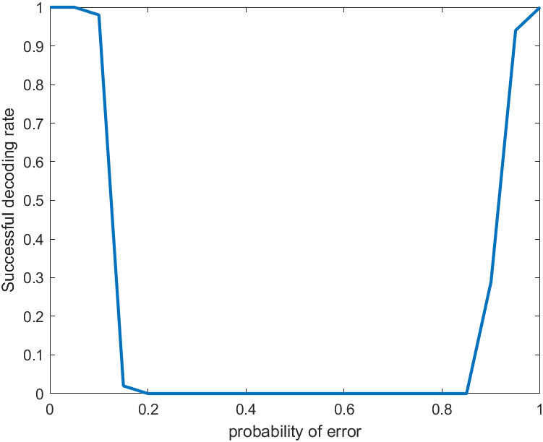
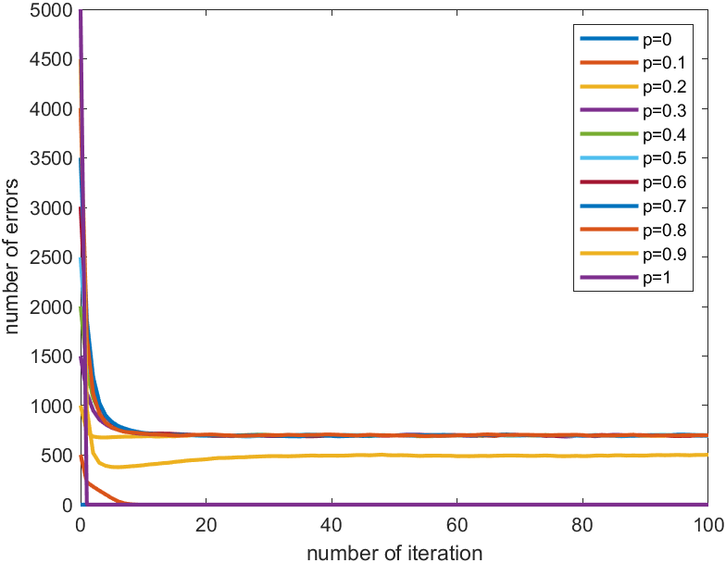
NUMERICAL RESULTS
For Hmatrix2:

Slide 31
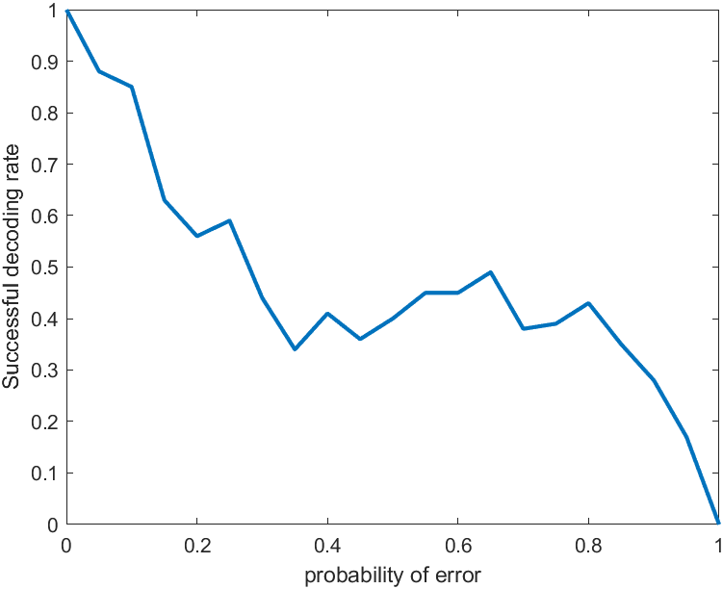
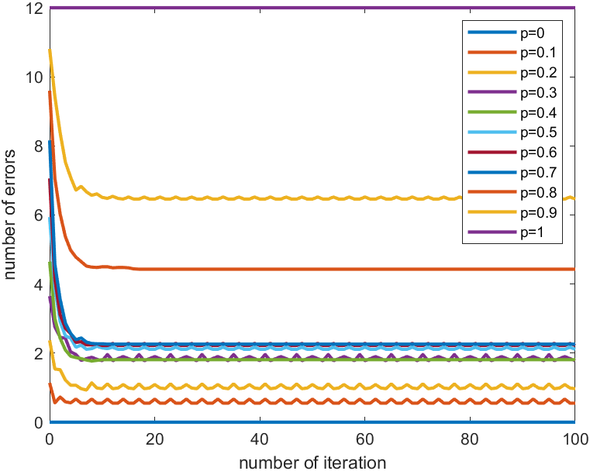
NUMERICAL RESULTS
For Hmatrix3:

Slide 32
NUMERICAL RESULTS
Validation of our results :
The success rate of the LDPC code depends upon the length of the code. Greater the length, higher will be the successful decoding rate.
Also, it depends on the ratio of the number of check nodes to the number of variable nodes. Higher the number of check nodes for particular number of variable nodes, higher will be the number of parity bits. Higher the number of parity bits, better will be the success rate.

Slide 33
NUMERICAL RESULTS
Hmatrix1 of size 3079 X 5056 has the better CN to VN ratio than Hmatrix2 of size 3000 X 5000, so the success rate of the Hmatrix1 is greater than the Hmatrix2.
Using the same logic, we can conclude that the matrix of size 9 X 12 also have the better success rate than the Hmatrix2.
Now, we would compare the Hmatrix1 and matrix of size 9 x 12. Both have the same CN to VN ratio, but the lengths of both the codes are not same. Length of Hmatrix1 is very large as compared to the other one. So, first matrix will have better success rate than the other.

Slide 34
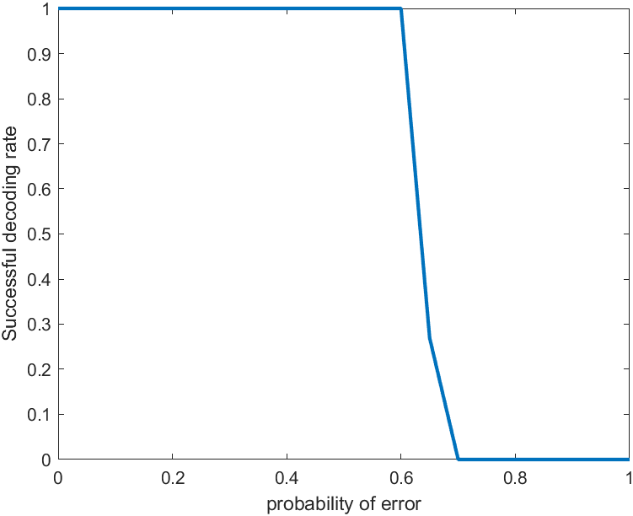
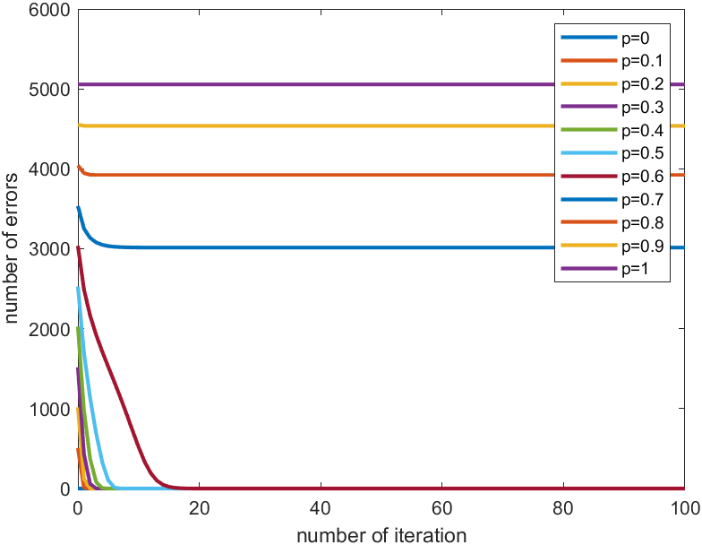
NUMERICAL RESULTS
b) BEC hard decision:
For Hmatrix1:

Slide 35
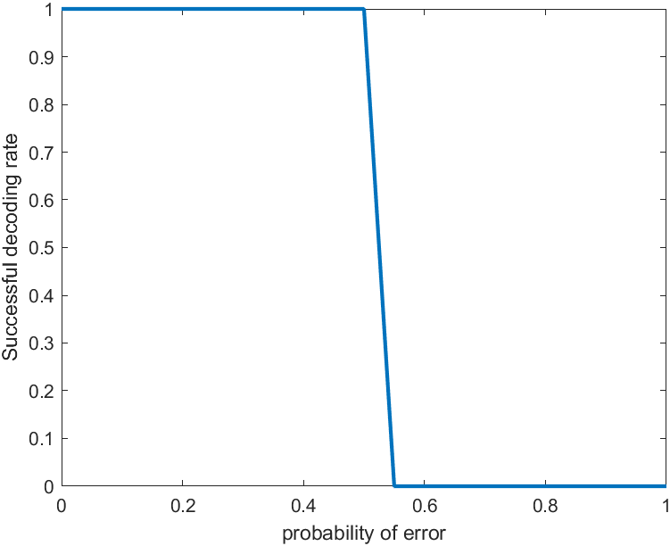
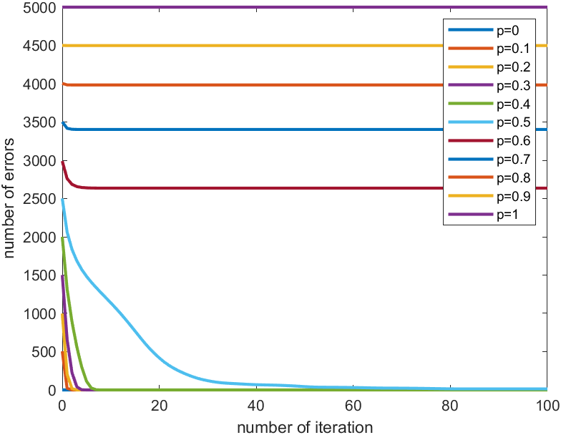
NUMERICAL RESULTS
For Hmatrix2:

Slide 36
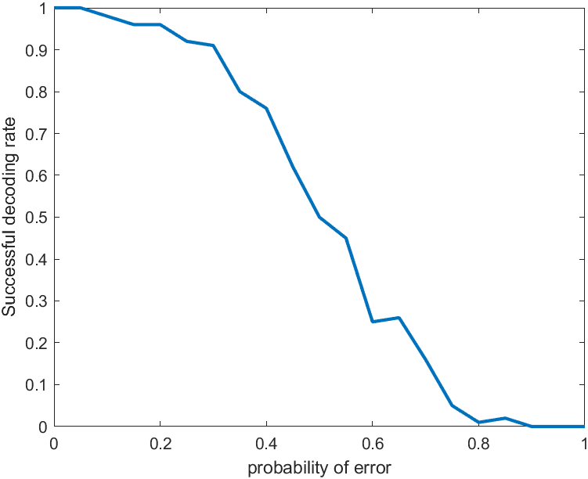
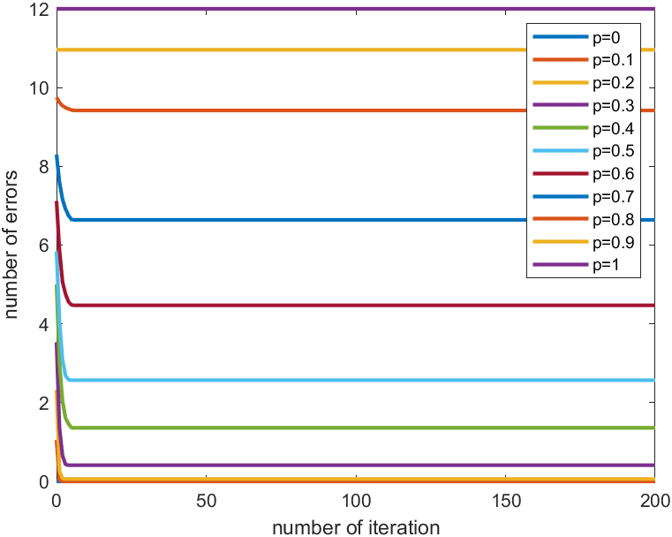
NUMERICAL RESULTS
For Hmatrix3:

Slide 37
NUMERICAL RESULTS
Validation of our results :
Using the same logic as that of the BSC hard, we can say that Hmatrix1 will have the best success rate and Hmatrix2 the worst.
We know that during the message transfer from CN to VN, if any one of the message is erased bit, CN transfers the erased bit. As the value of p increases, the number of erased bits in received sequences increases and so for very first iteration, more than 50% variable nodes that are connected to check node contain erasers. And so most of the CN would send the eraser to VN and as a result, for higher values of p, decoder would not be able to decode and so success rate becomes zero.

Slide 38
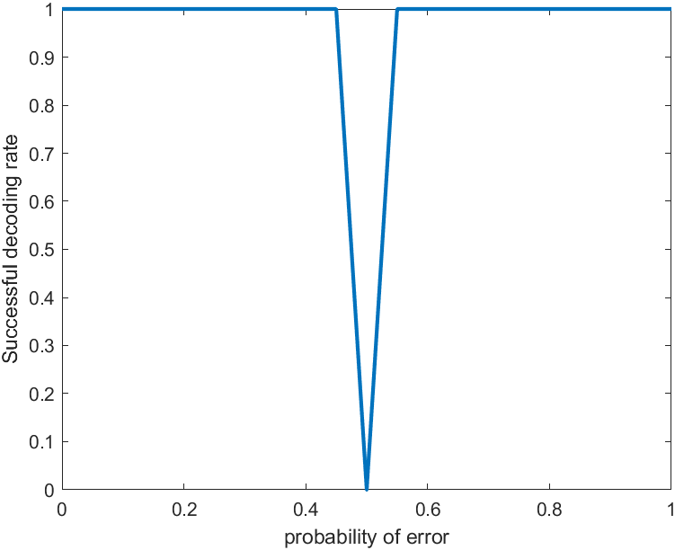
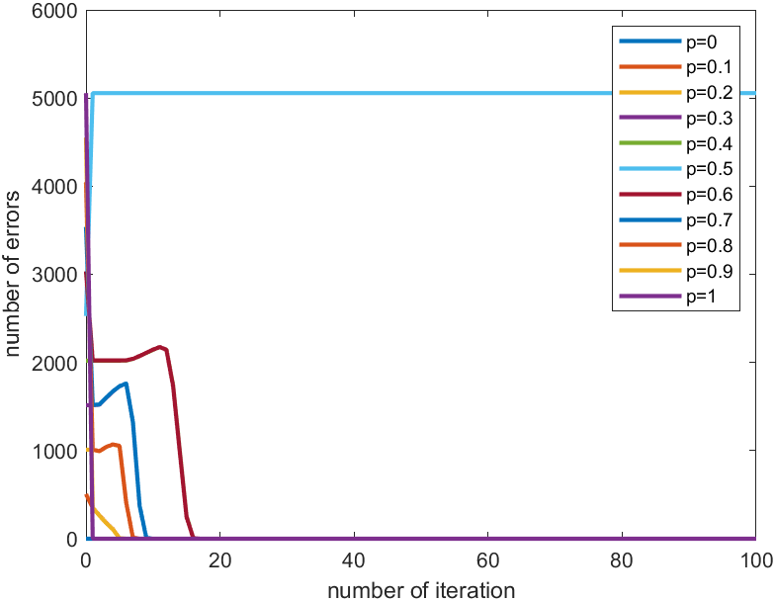
NUMERICAL RESULTS
c) BSC soft decision:
For Hmatrix1:

Slide 39
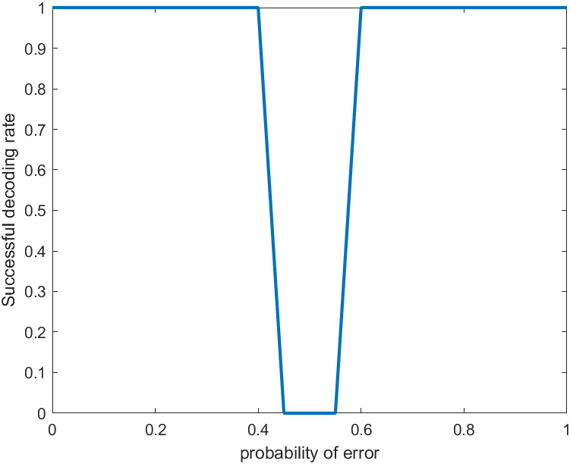
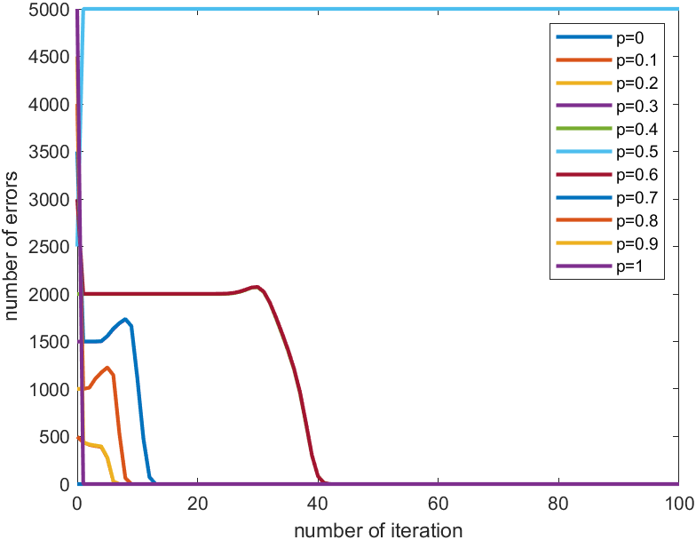
NUMERICAL RESULTS
For Hmatrix2:

Slide 40
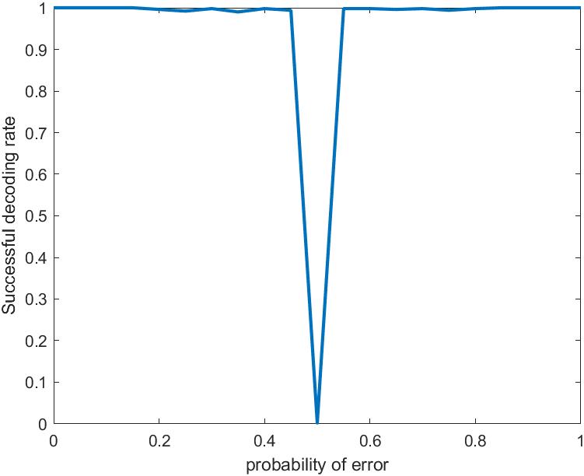
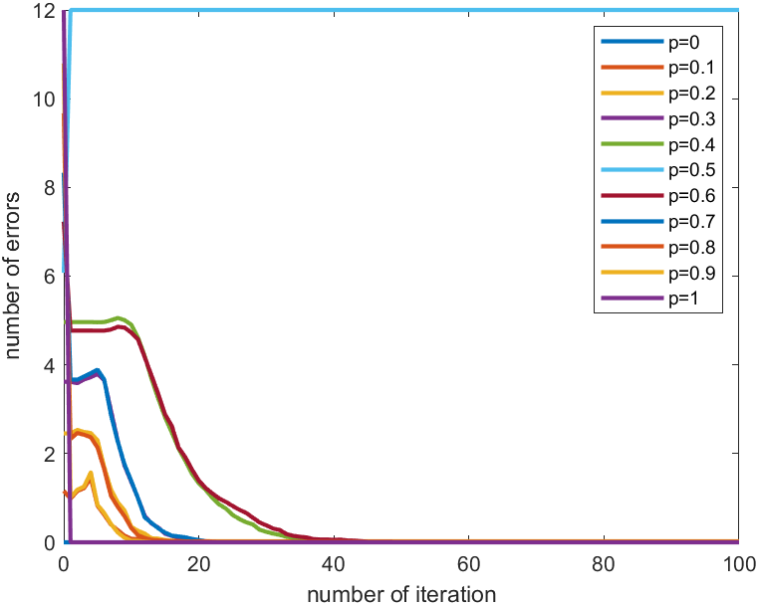
NUMERICAL RESULTS
For Hmatrix3:

Slide 41
NUMERICAL RESULTS
Validation of our results :
Here in soft decision, we use probabilities - more specifically, soft decoding works on the Bayesian theorem, and we assume that the probability of error is known to the receiver, Thus, we can easily say that we will get same result for p and (1-p) value of probabilities. It is clearly understood that the graph will be mirror symmetric around p=0.5. For p= 1, we can say that receiver will know that it have to flip all the bits and so success rate becomes 1.
The second thing is that when p’s value approaches 0.5, the value of the likelihood ratio approaches 1 and so it decides that 1 has been transmitted. And so the successful decoding rate is becoming 0 for that range of probability.

Slide 42


NUMERICAL RESULTS
d) BEC soft decision:
For Hmatrix1:

Slide 43


NUMERICAL RESULTS
For Hmatrix2:

Slide 44
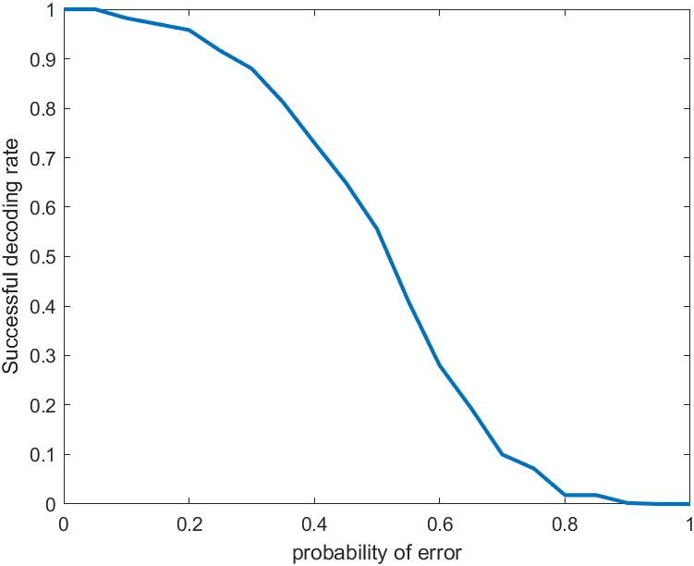
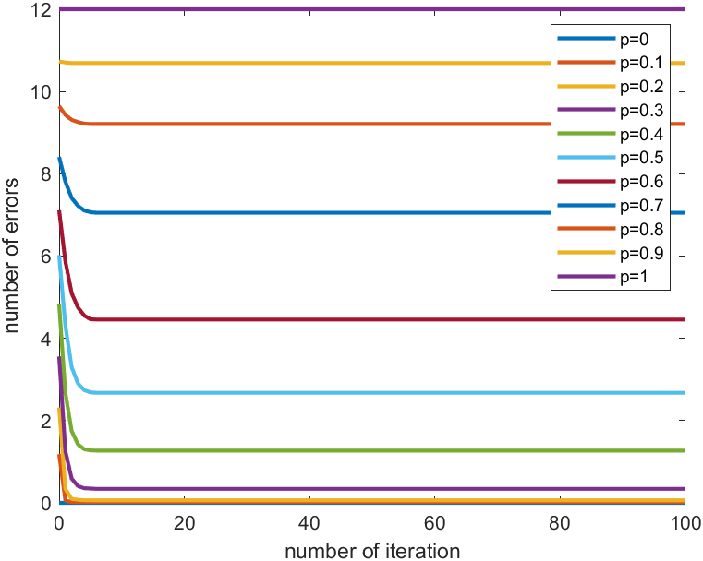
NUMERICAL RESULTS
For Hmatrix3:

Slide 45
NUMERICAL RESULTS
Validation of our results :
For the BEC soft decoding, the success rate is 1 for lower value of p since the receiver would be sure that all the bits that were not erased would be correct and the erased bit can be easily decoded using the parity bits.
The success rate decreases as the value of p increases since increase in p results in increase in the number of the erasure bits and as mentioned earlier, in previous case of BSC, receiver can flip bits for higher value of p but for BEC, receiver cannot decide whether the erased bit was 1 or 0. That’s why the success rate is zero for higher values of p.

Slide 46
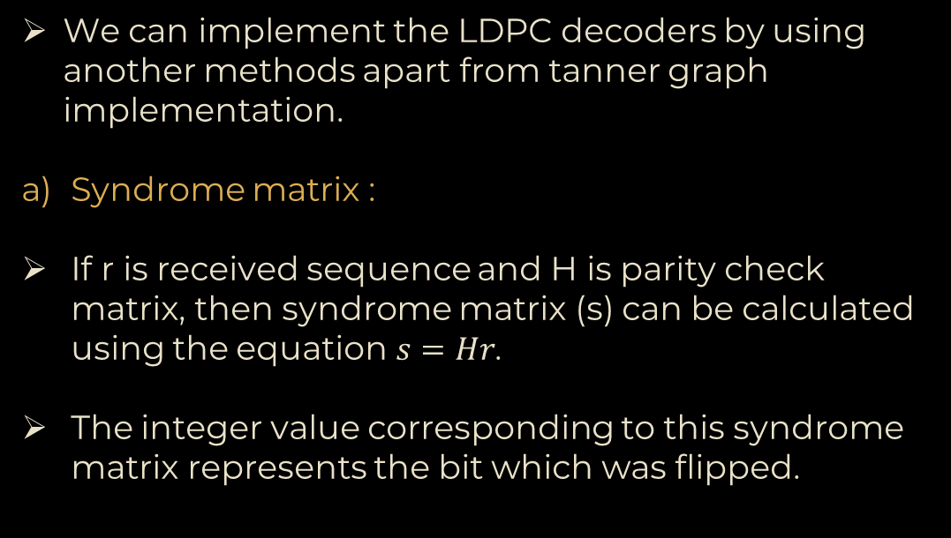
ALTERNATE WAYS OF IMPLEMENTATION OF DECODER
We can implement the LDPC decoders by using another methods apart from tanner graph implementation.
Syndrome matrix :
If r is received sequence and H is parity check matrix, then syndrome matrix (s) can be calculated using the equation$s=Hr$.
The integer value corresponding to this syndrome matrix represents the bit which was flipped.

Slide 47
ALTERNATE WAYS OF IMPLEMENTATION OF DECODER
Limitations of syndrome matrix :
As the size of the H matrix increases, the space complexity increases exponentially. So, for a large H matrix, this is not the preferred way.

Slide 48
ALTERNATE WAYS OF IMPLEMENTATION OF DECODER
b) Standard array decoding :
It's an array or a table, in which all 2^{n} possible received vectors r are listed. The table has 2^{k} columns(k is information bits). The head of each column is a valid code-word ‘c’. The remaining entries in that column correspond to non-valid r vectors that belong to the Hamming sphere corresponding to the column-head (i.e., a valid codeword)
A table lookup is performed on receiving a vector r. The column to which this r belongs in the standard array is looked up. The decoded code-word is the head of that column.

Slide 49
ALTERNATE WAYS OF IMPLEMENTATION OF DECODER
Limitations of standard array decoding :
As the size of the H matrix increases, the space complexity increases exponentially. So, for a large H matrix, this is not the preferred way.

Slide 50
4
MONTE CARLO SIMULATION

Slide 51
MONTE CARLO SIMULATION
We performed the Monte Carlo simulation varying error probability p from 0 to 1 by incrementing 0.05 every-time.
For each value of p(crossover probability for channel), we perform N_{sim} simulations. If the decoder would not be able to decode the message then we increment the value of N_{err} which is initialized to 0.
The probability of successful decoding of the received message is equal to the ratio of (N_{sim} - N_{err}) to N_{sim}.

Slide 52
5
SUMMARY

Slide 53
SUMMARY
Considering all aspects like tanner graph implementation, implementing BEC/BSC channel, understanding multi-maps we found this project moderately hard.
Here we have used tanner graphs which are a type of bipartite graphs.
The bipartite graph can also be used in Query Log Analysis, which is used to improve search engine capability. Query Log Analysis would maintain the query with each respective website so searching becomes easy in search engine, the bipartite graph between search engine and URLs.

Slide 54
SUMMARY
In Query Log Analysis method edges connected the query with its appropriate URL and capture some semantic relation between the query and the URLs.
In 2009 Netflix gave a $1Million prize to the group that was best able to predict how much someone would enjoy a movie based on their preferences. This can be viewed as a bipartite graph problem.
The viewers are the vertices U and the movies the vertices V and there is an edge from u to v if u viewed v. In this case the edges are weighted by the rating the viewer gave

Slide 55
6
CONTRIBUTION TABLE

Slide 56
CONTRIBUTION TABLE
Topic | Name | ID | Contribution
BEC & BSC Channel coding | Om Limbachiya Parth Thakrar | 202001443 202001450 | Implementation of channel
Software Implementation of Tanner Graph | Achyut Shah | 202001449 | Implementation of tanner graph
BEC-Hard Decoder | Hetav Vakani Priyanshu Parmar Achyut Shah | 202001447 202001448 202001449 | Functional and unit testing of the code, Monte-Carlo simulation
BSC-Hard Decoder | Krunal Patel Venil Gondaliya Achyut Shah | 202001445 202001446 202001449 | Functional and unit testing of the code, Monte-Carlo simulation

Slide 57
Topic | Name | ID | Contribution
BEC-Soft Decoder | Gaurang Parmar Achyut Shah Parth Thakrar | 202001444 202001449 202001450 | Functional and unit testing of the code, Monte-Carlo Simulation
BSC-Soft Decoding | Krunal Patel Om Limbachiya Achyut Shah | 202001442 202001443 202001449 | Functional and unit testing of the code, Monte-Carlo Simulation
Power Point Presentation | Om Limbachiya Gaurang Parmar Parth Thakrar | 202001443 202001444 202001450 | Designing and Content

Slide 58
The MVP OF THE GROUP
Achyut Shah - 202001449

Slide 59
7
REFERENCES

Slide 60
REFERENCES
Lecture’s slides
LDPC Codes – a brief Tutorial Bernhard M.J. Leiner
https://in.mathworks.com/help/comm/ref/comm.ldpcdecoder-system-object.html#bs8gdxn-1_head
https://en.wikipedia.org/wiki/Low-density_parity-check_code#:~:text=In%20information%20theory%2C%20a%20low,subclass%20of%20the%20bipartite%20graph).

Slide 61
8
APPENDIX

Slide 62
APPENDIX
What is Tanner Graph ?
Tanner graphs are bipartite graphs that are used to express constraints or equations that describe error correcting codes.
Tanner graphs are used in coding theory to build longer codes from smaller ones.
These graphs are heavily used by both encoders and decoders.

Slide 63
APPENDIX
What is Channel Coding ?
In digital communication systems, channel coding is the process of identifying and fixing bit errors.
Channel coding allows the receiver to detect and rectify mistakes caused by noise, interference, and fading during transmission.

Slide 64
APPENDIX
What are the LDPC codes ?
LDPC - low-density parity-check code
A code described by a parity-check matrix with the following features is known as a low-density parity-check code. Each column has a tiny fixed number of ones, and each row has a small set number of ones as well (greater than columns)
LDPC codes are linear error correcting code, a method of transmitting a message over a noisy transmission channel.
An LDPC is constructed using a sparse Tanner graph.

Slide 65
THANK YOU!

